Slide 1
Employee Data Analysis using Excel
STUDENT NAME: A.suriya
REGISTER NO: 312219005 ( asunm1701312219005 )
DEPARTMENT: B.COM (General)
COLLEGE: Apollo Arts and science college

Slide 2
PROJECT TITLE
Employee department data using Excel

Slide 3


AGENDA
Problem Statement
Project Overview
End Users
Our Solution and Proposition
Dataset Description
Modelling Approach
Results and Discussion
Conclusion
3/21/2024 Annual Review

Slide 4

PROBLEM STATEMENT Employee department data is a critical factor influencing organizational success, requiring effective assessment and management strategies. Addressing performance issues can enhance productivity and employee satisfaction. An employee dataset overview provides essential insights into workforce demographics, performance metrics, and engagement levels. Crucial for optimizing human resource strategies. Proper analysis can reveal trends and gaps, aiding in targeted improvements.

Slide 5

PROJECT OVERVIEW
.The project involves analyzing employee department data using Excel to gain insights into workforce metrics. This includes organizing data, performing statistical analysis, and creating visualizations to understand trends in employee performance, demographics, and other key indicators, thereby supporting data-driven decision-making for HR strategies.

Slide 6
PROJECT FOCUS: This project focuses on leveraging Excel to analyze employee department data. Key tasks include; 1. Data organization: Importing, cleaning, and structuring employee data for clarity and consistency. 2. Analysis: Applying Excel functions and formulas to assess performance metrics, filling missing values, and other key indicators. 3. Visualization: Creating charts, graphs, and pivot tables to visualize trends and patterns. 4. Reporting: Summarizing finding of HR strategies and decision making.

Slide 7

WHO ARE THE END USERS? The end users in employee department data analysis typically include: 1. Human Resource (HR) Managements: They use the insights to make informed decision about promotions, training, and development. 2. Team Leaders and Supervisors: They apply performance data to provide feedback, set goals, and manage team performance. 3. Employees. They benefit from feedback and performance evaluations that help them improve and advance in their careers.

Slide 8

OUR SOLUTION AND ITS VALUE PROPOSITION *Filtering – to fill the missing values. *Conditional formate- blank values. *Using-Pivot table & chart.

Slide 9
Dataset Description Employee data set – Kaggle there are26 feature ID The important ten feature are, *Deparment *Employment ID *First Name *Last Name *Gender *Employee status *Performance score

Slide 10
*Current employee rating *Business units

Slide 11

THE "WOW" IN OUR SOLUTION Performance level – The re are categories into levels such as very High, High, Med, Low, etc... Using pivot table and charts is to analyse the employees performance.
3/21/2024 Annual Review
11

Slide 12
MODELLING
Data preparation: Clean and organize data and, ensuring accuracy and consistency.
Trend Analysis: Apply charts and graphs (e.g., line charts, bar graphs) to visualize trends over time, such as employee performance or turnover rates.
Pivot tables: Create pivot tables to aggregate and analyse data across different dimensions, such as department, tenure, or job role.
12

Slide 13
Regression Analysis: Utilize regression functions to identify relationships between variables, such as the impact of training
On performance.

Slide 14
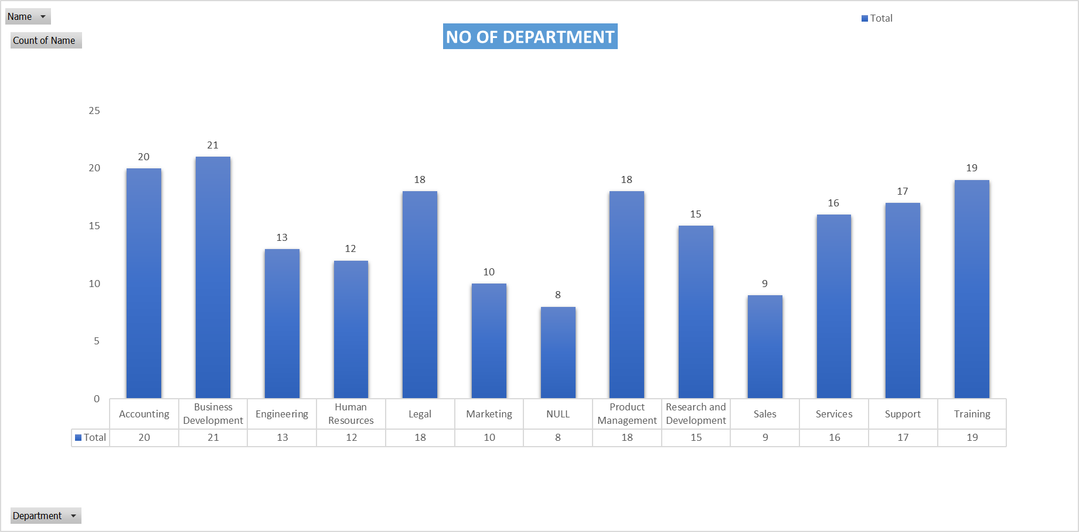
RESULTS
14

Slide 15
Conclusion The conclusion of employee department data analysis reveals key insights into workforce trends, performance, and areas for improvements. By analyzing metrics productivity, turnover rates, and engagements levels, organizations can identify strengths and weaknesses in their HR strategies. This analysis supports data-driven decision-making, enabling targeted interventions to enhance employee performance, optimize recruitment processes, and improve overall organizational effectiveness. In essence, effective data analysis provides a foundation for strategic planning and operational improvements, leading to a more motivated and productive workforce.

